Slide 1
Hackathon 2017
Waste Collection Analysis
Team Affinity
Ganesh Taduri
Gulnoza Khakimova
Raghava Kundavajjala

Slide 2
Problem Statement and Motivation
Waste collection in cities is an everyday task happens at fixed schedules whether containers are full or not, which results in wastage of lots of resources, equipment and human effort.
The motivation behind this project is to develop an application which optimizes the resource management by using smart wireless sensors to collect and report fill-level data.
This application provides
Customers to automate schedule planning,
Optimize routes,
Reduce equipment wear and emissions and
Provide better customer service.
.

Slide 3
Solution
We developed a solution to the above problem by implementing Floyd Warshall Algorithm. The proposed solution is as follows.
Represent the containers in a city with a Graph G(V,E) where V represents the containers and E represents the route between the containers. Weights on the edges represents the distance between the containers.
By using Floyd Warshall Algorithm, shortest path from each container to every other possible container is calculated.
The fill level data of container received by smart wireless sensors is stored in a graph g(v,e) where v ⊂ V and e ⊂ E.
Now finding shortest path between a source and destination in g(v,e) using the results from Floyd Warshall Algorithm such that the path covers all the nodes in graph g(v,e) ensures that it is the best optimal path possible.

Slide 4
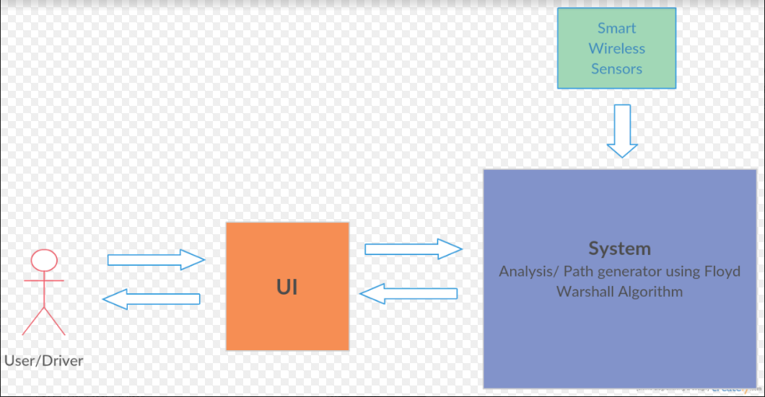
Architecture Diagram

Slide 5
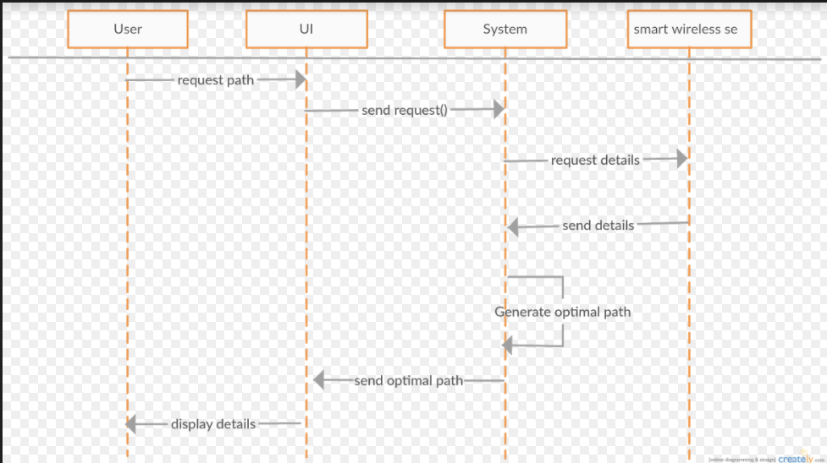
Use case Diagram

Slide 6
References
[1] http://www.cs.umd.edu/~meesh/351/mount/lectures/lect24-floyd-warshall.pdf
[2] https://data.kcmo.org/
[3] http://www.enevo.com/
[4] https://www.youtube.com/watch?v=VE9XIhif6oE
[5] http://www.gtkmm.org/en/

